Slide 1
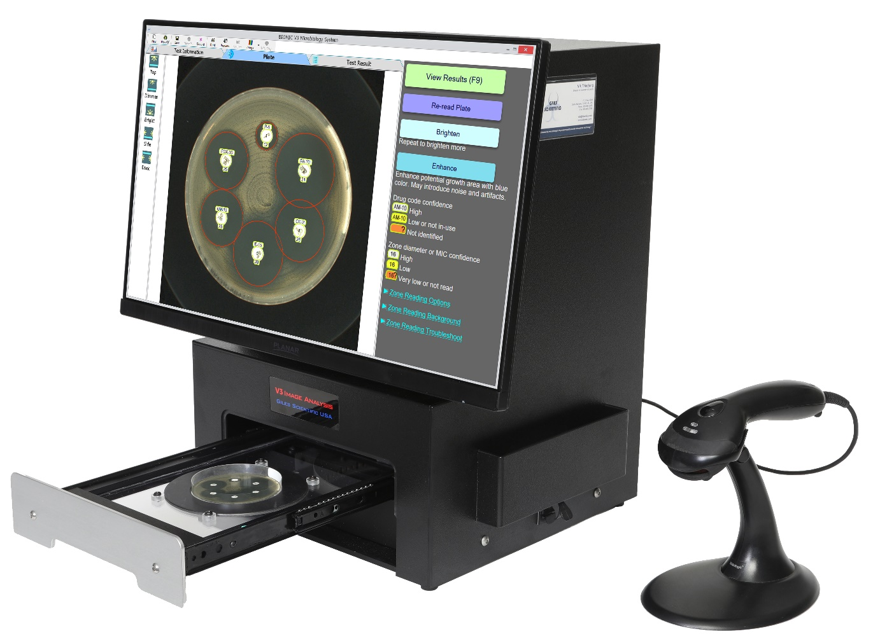
www.biomic.com

Slide 2
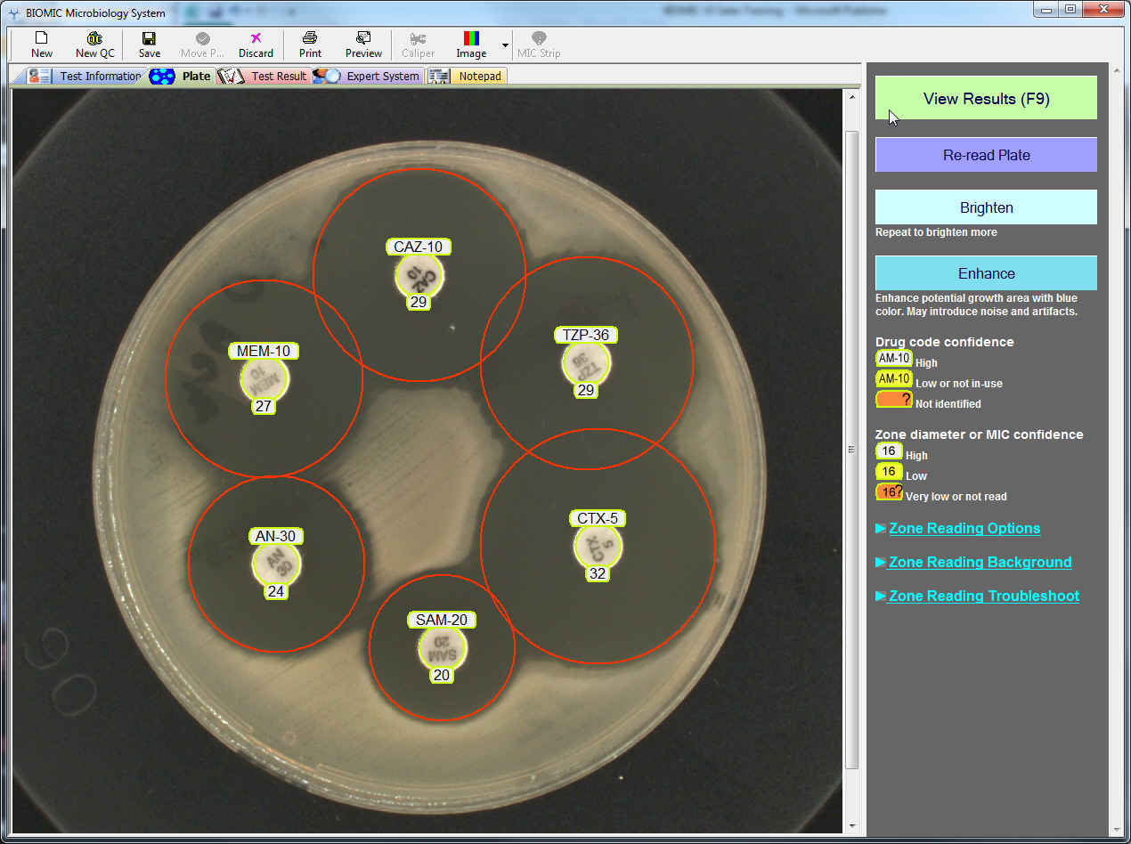
Disc Diffusion Zone Reading
1 second plate reading time

Slide 3
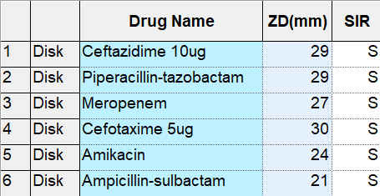
Disc Diffusion Zone Reading
Current EUCAST & CLSI Interpretations

Slide 5
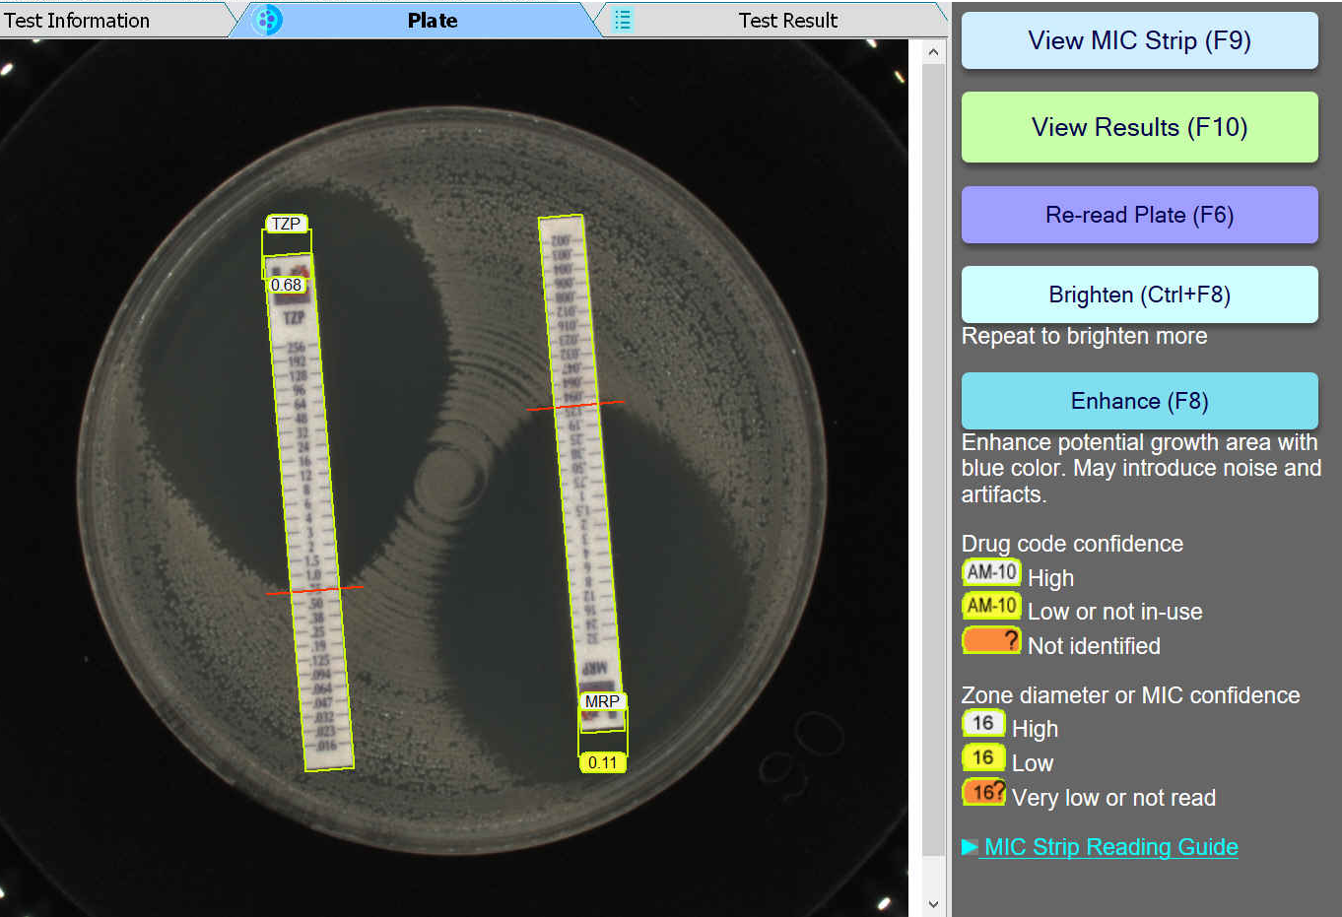
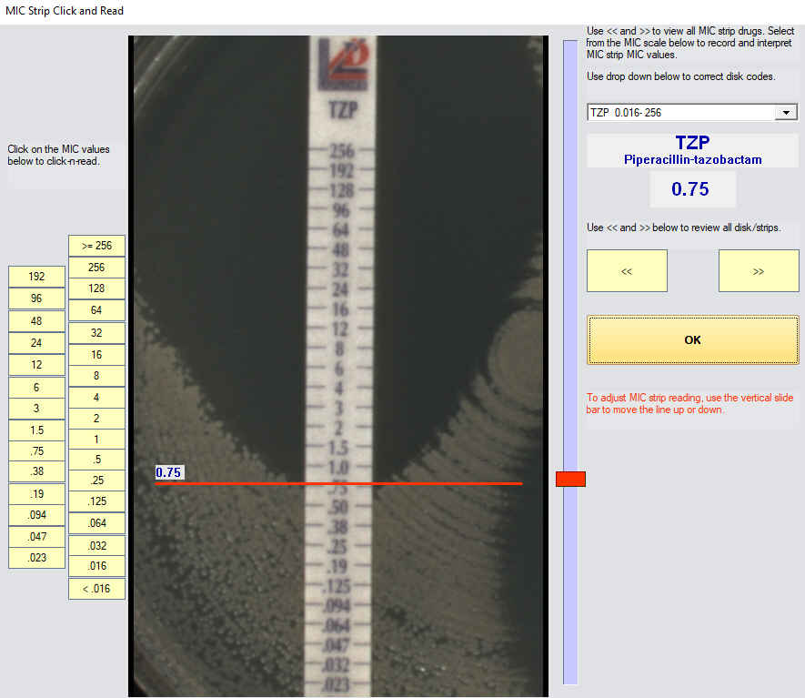
MIC Test Strip (Liofilchem®)

Slide 7
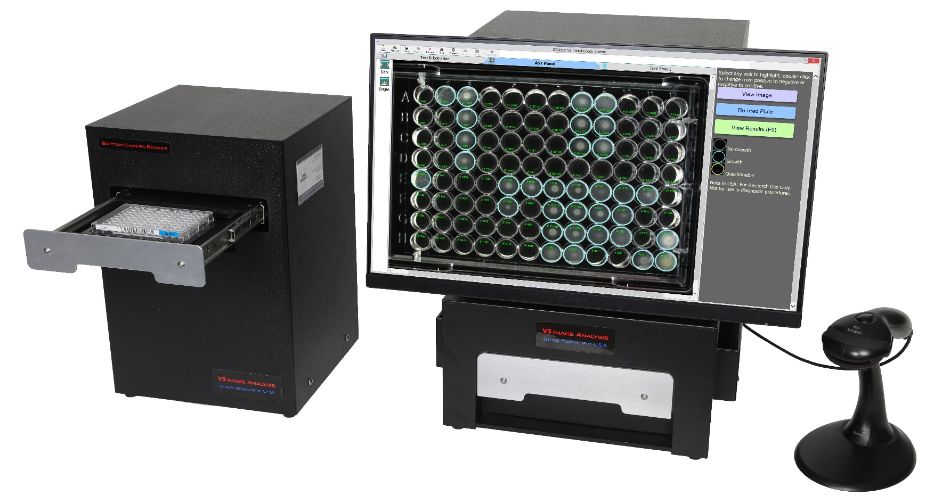
Broth Microdilution

Slide 8
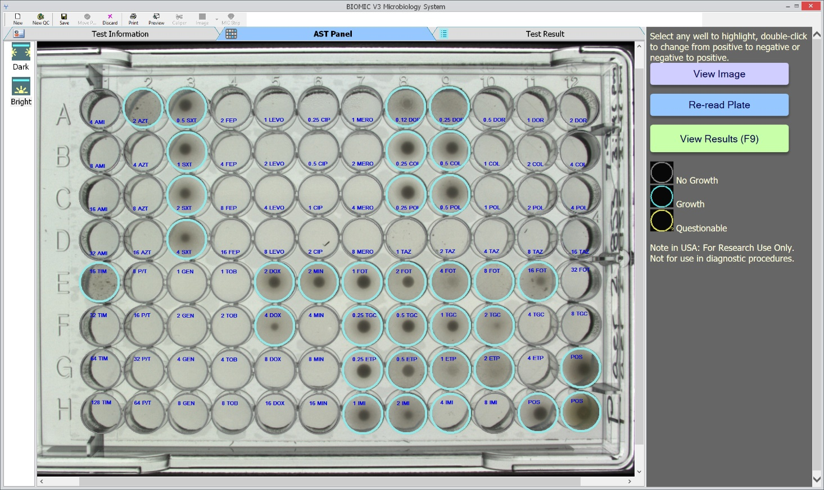
Broth Microdilution
Brightfield Lighting

Slide 9
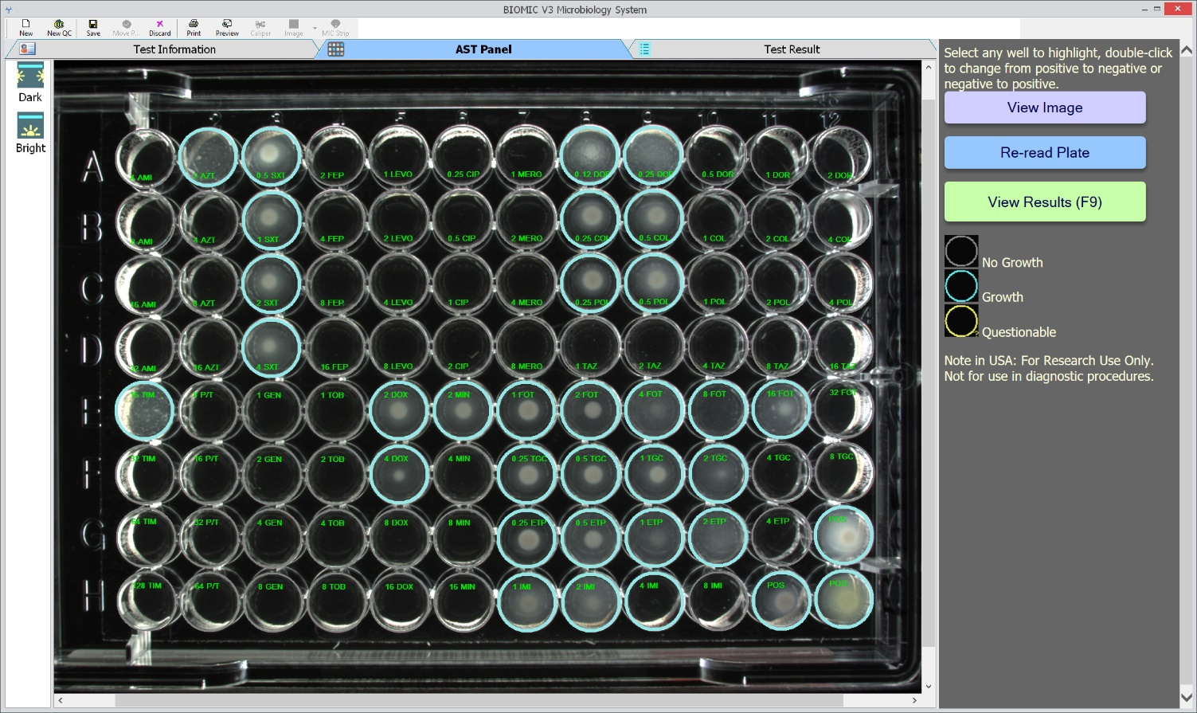
Broth Microdilution
Darkfield Lighting

Slide 11
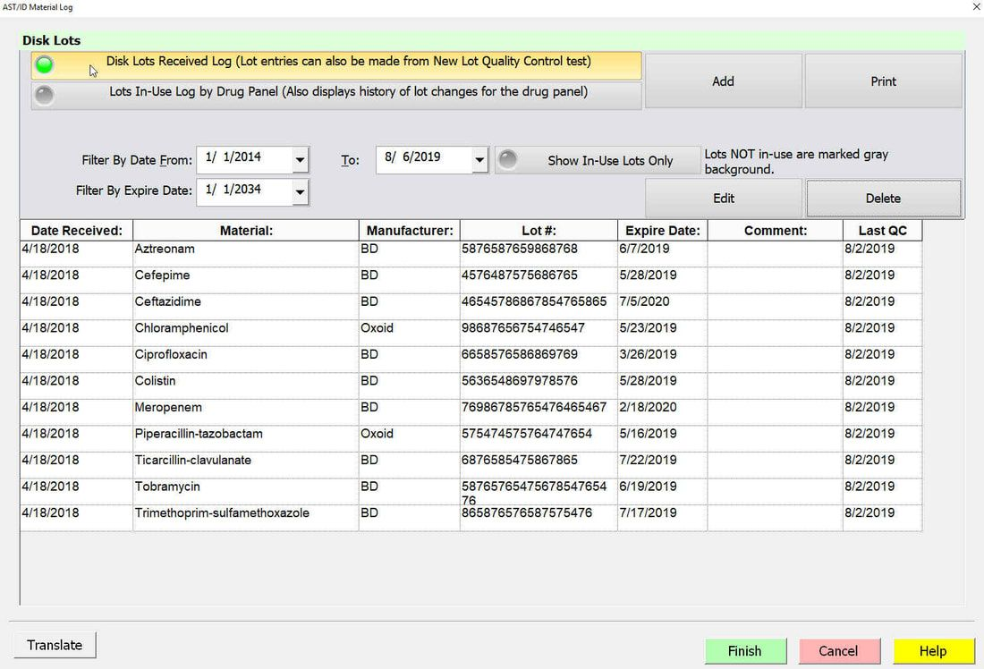
QC & Inventory Management
Discs, MIC Strips, Plates, Panels, Media, Reagents

Slide 12
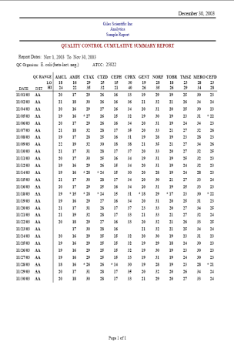
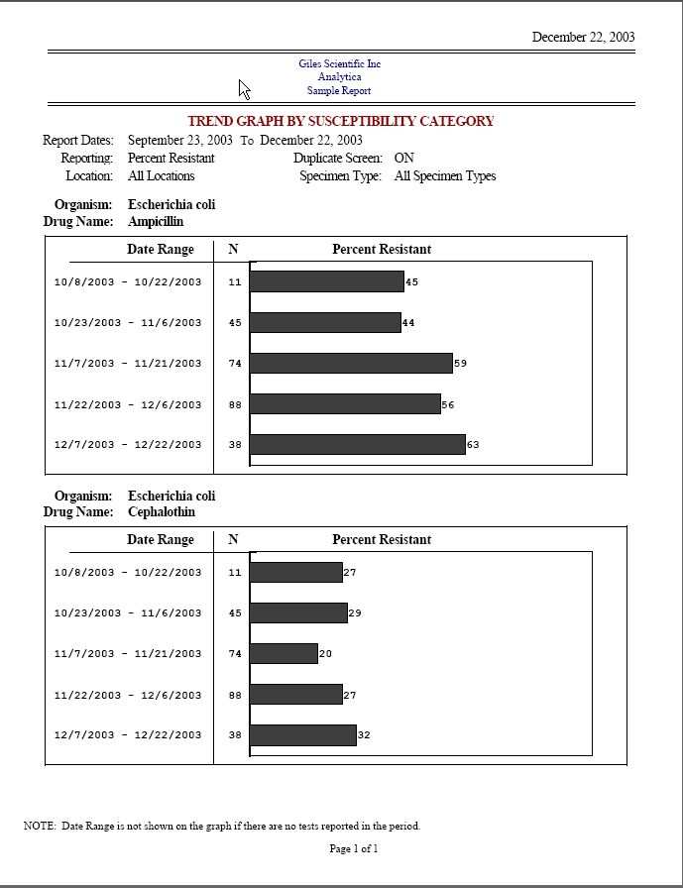
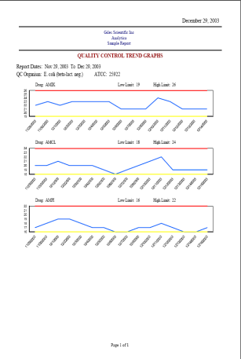
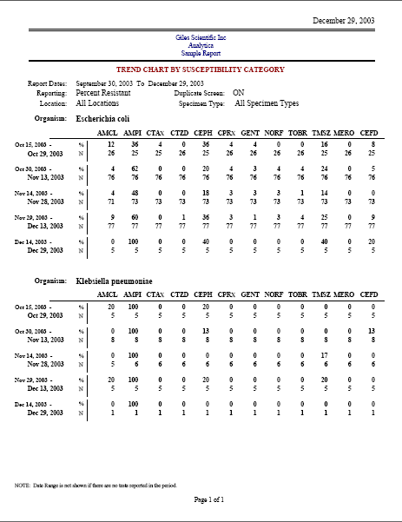
Antibiogram & QC Reports

Slide 14
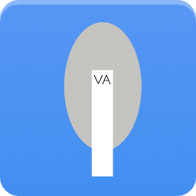
Optional Testing Modules
Disc Diffusion
Organism ID
MIC Strip
Colony Count
Broth Microdilution
Agar Dilution

Slide 15
Key Features
IVDR approved
Instant & standardized reading
Test results & images saved
EUCAST & CLSI interpretation
24 inch touch screen monitor
2-way LIMS interface
No routine maintenance
Designed and manufactured by Giles Scientific Inc in Santa Barbara, California, USA.

